Slide 2
Develop and launch a platform as a service to support all 687,000+ foster children in the U.S. through the nearly 1,000 Court Appointed Special Advocates (CASA) programs nationwide
WHO ARE WE? Voices for Children is the largest, self-funded CASA program in the nation and has created a model which serves every child in our county, plus we are the ONLY organization with DIRECT ACCESS & DATA to every foster child
CASA programs are demanding a cost-effective standardized method of data collection, case planning tools, and access to resources
Our PaaS will utilize Artificial Intelligence to build on existing data → predictive solutions
Voices for Children: 38 years of experience - “elite” program in the nation
$1.7B market which currently relies on donations → licensing revenue model to support all CASA orgs
$1M gets us to breakeven by year 3 and profitable by year 4

Slide 3
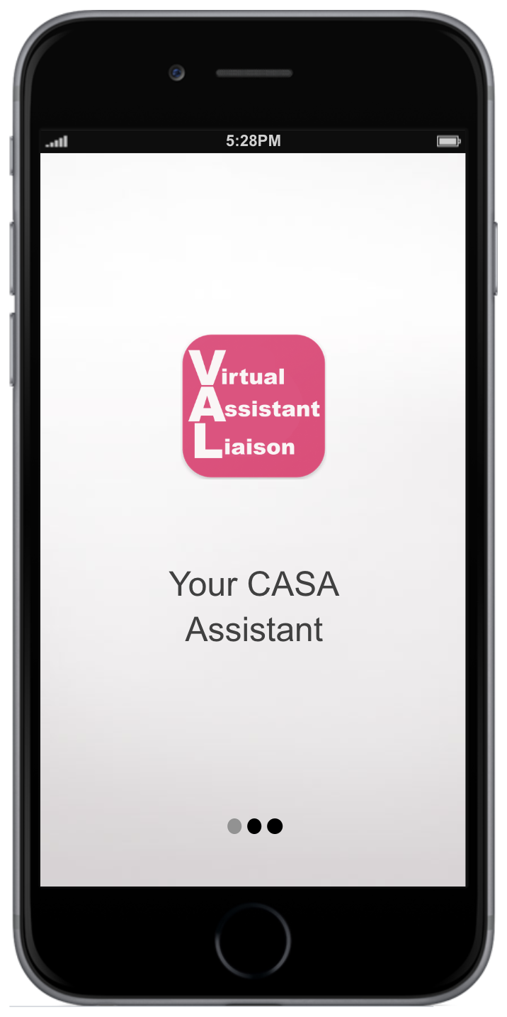
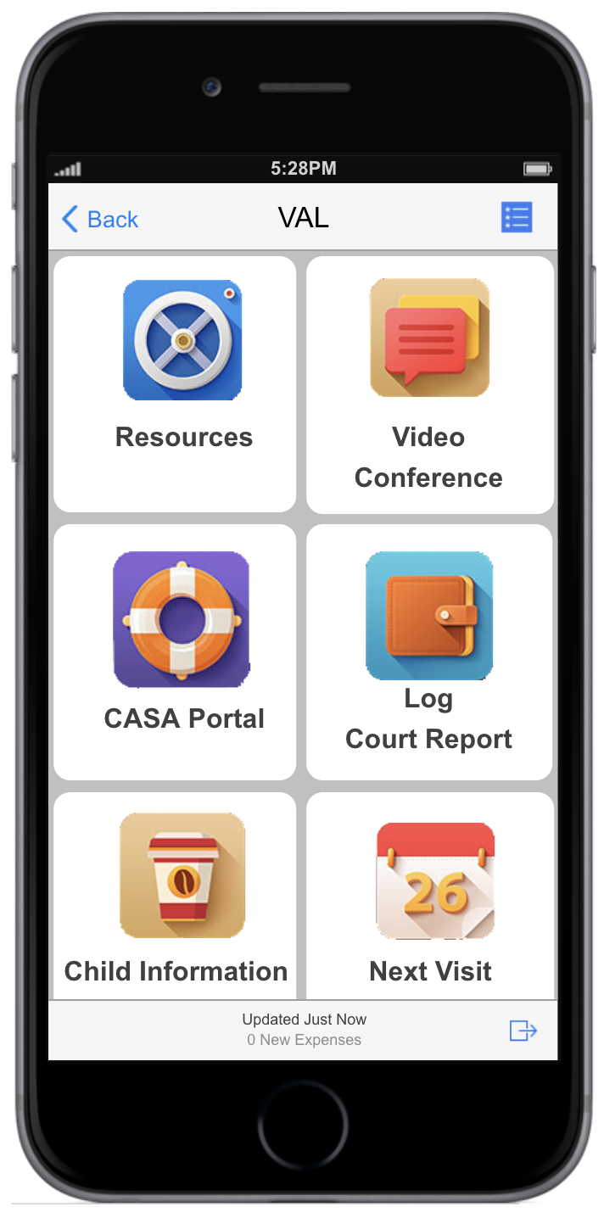
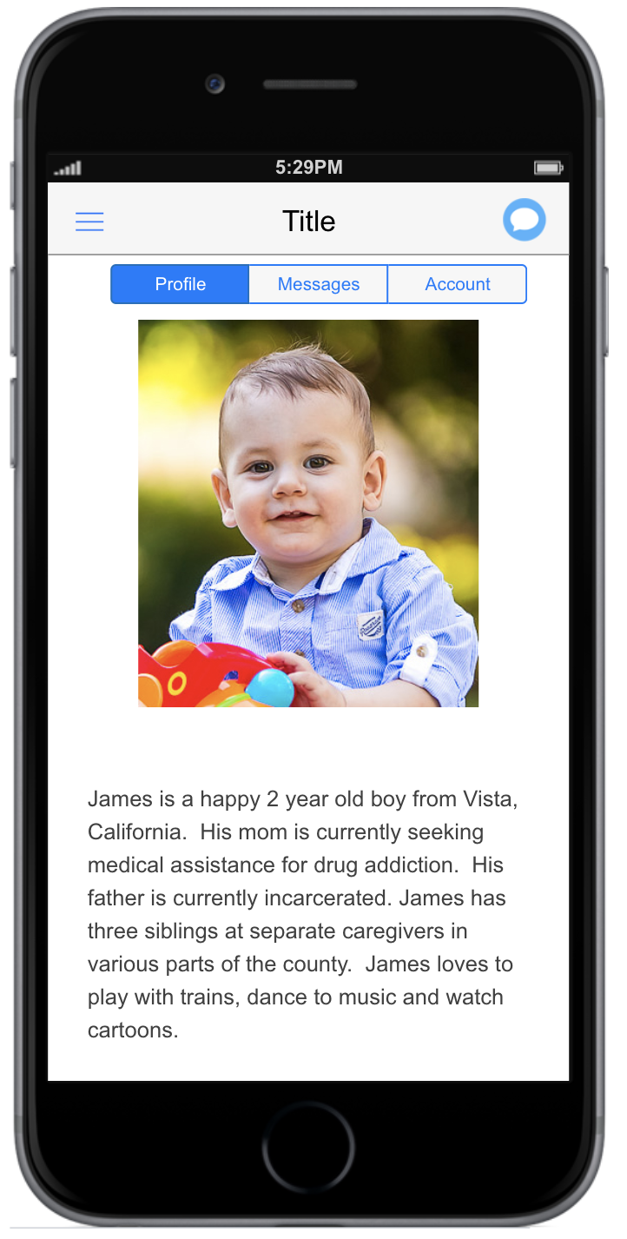
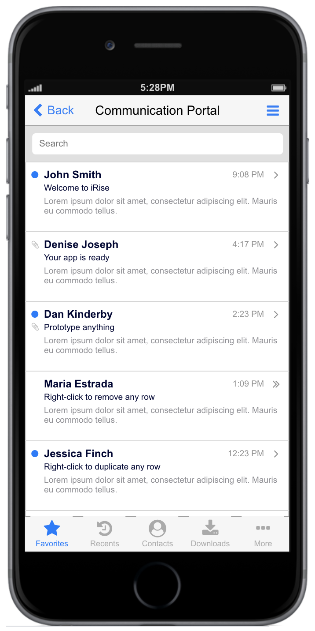
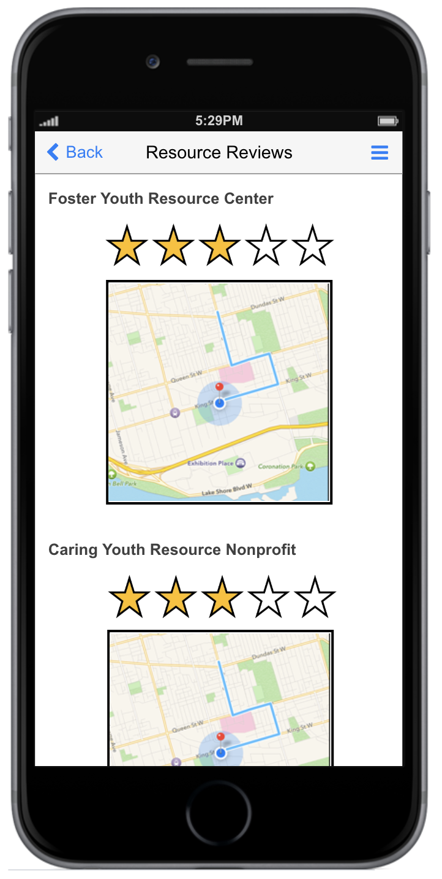
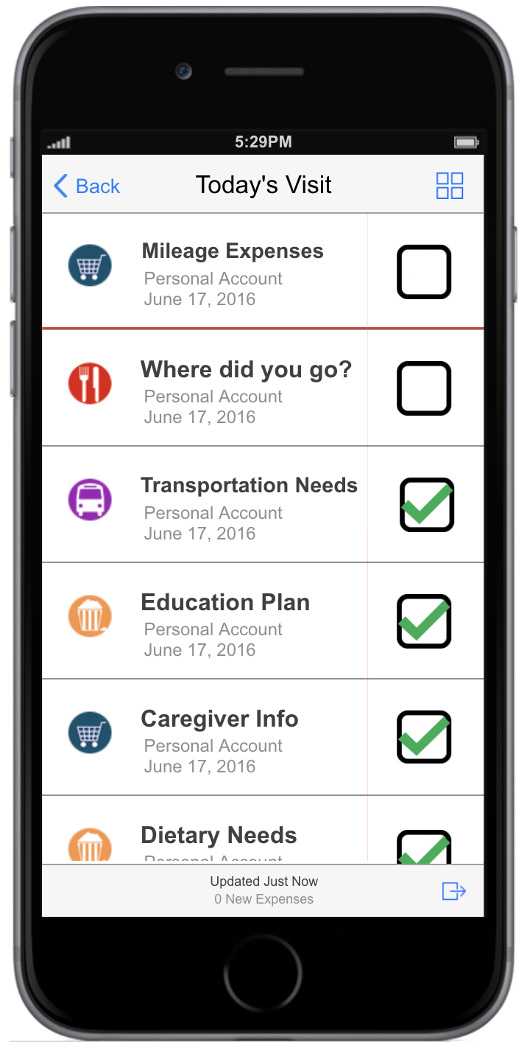
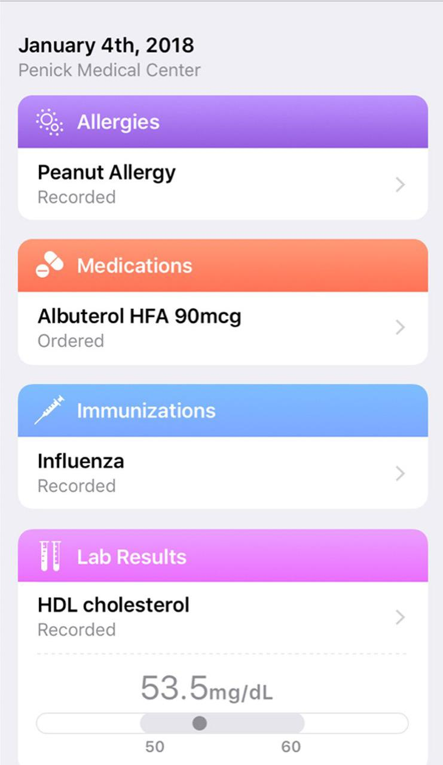
A multi-tiered cloud based platform as a service
Mental & Physical
Health
Assessment
Case Planning
Guide
Artificial Intelligence
Online
Court Report
Builder
Resource Portal
Yelp-type
Reviews
Action Item Tracking System
Notes:
GO DEEPER INTO WHAT WE’RE GOING TO DO WITH THE DATA
CASAs & staff track information including health and wellness indicators in a centralized database
Technology increases efficiency by freeing up staff & volunteer time to 1) serve more children and 2) serve them better based on data-driven best practices
Artificial Intelligence provides two-way data collection and connects available resources to users through app

Slide 4
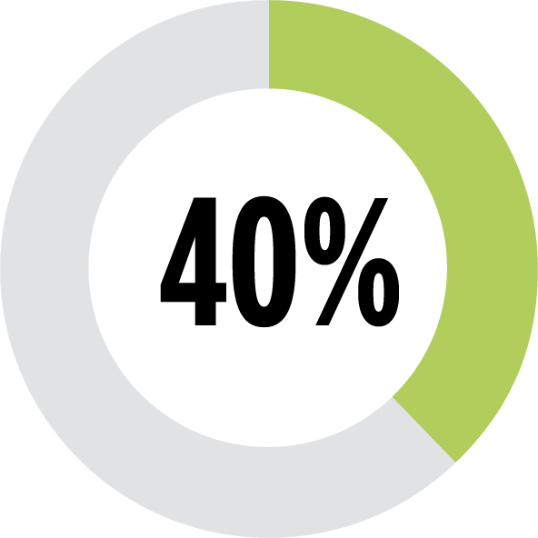
$6.5M
Notes:
6.5M to run our org,
Slow - takes months to do a process that could be done in a day
Resources are constantly changing - NEED DATA
Need Data collection
Need Case planning
BE VERY SPECIFIC ABOUT EFFICIENCIES AND QUANTIFY COST SAVINGS
communication and tracking data, statistics, and reporting efficiency and effectiveness
mental and physical health education living and transportation extra-curricular financial and legal

Slide 5
VFC Staff
Current Youth
Former Foster
Youth
Social Services
CASAs
Judges
Attorneys
Notes:
Current CASA databases are designed around the mother, not the child
Focus groups & surveys - what is working? What is missing?
Presiding Judge Lagotta’s needs - on the bench a tablet
Stakeholders need…..
Pain points learned from focus groups (staff, CASAs, judges, other CASA organizations)
FASTER user experience
HOW ARE WE OFFSETTING THIS NEED FROM A SOCIAL STANDPOINT - WHAT IS THE REDUCTION IN NUMBERS
COULD ADD LINE AT END… WILL REDUCE THESE NUMBERS IN SAN DIEGO
Provide greater impact in the lives of foster children who are minorities (55%), those who identify LGBTQ (19.2%) and other marginalized communities

Slide 6
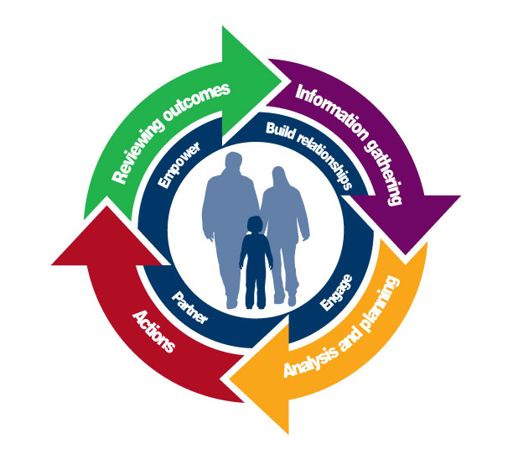
$2,500/child
$1.7B Market
$1,500/child
$670,000,000 annual savings
Notes:
Automate Bureaucracy
CONSERVATIVE ESTIMATE, “WE PROPOSE OUR TECHNOLOGY WILL…”
MATCHING GOING FROM ONE WEEK TO SAME DAY
REDUCE COST, GIVE EXAMPLE OF COST
Virtual Advocacy Liaison - “VAL” A one-stop shop which lowers the costs to serve every foster child The national cost to serve every child: $2,500/year X 687,000 neglected or abused children = $1.7B annually The proposed application will include a revolutionary health assessment utilizing artificial intelligence that will establish a baseline from the moment a child enters dependency, and the ability to enter data in real-time, which will dramatically shorten the time between a child’s initial health assessment and access to needed services. New insights into health issues affecting foster youth will prompt improvements to the entire foster care system itself. Reduces costs such as: Child’s assessment of needs Matching children to available volunteers Case planning

Slide 7
687,000 children
Notes:
60% of all child sex trafficking victims have histories in the child welfare system
Many young adults raised in foster care lack the skills and guidance to prepare them for entering the workforce.
Youth in foster care are at an increased risk for a variety of physical, mental, and emotional health issues.
Without stable and supportive home environments, many foster youth face special difficulties in school.
User Experience improvs for all stakeholders
DATA!
GO DEEPER IN IMPACT IN HOW WE’RE GOING… DETAILS OF THE SOLUTION
POTENTIAL IMPACT MARKET 400,000
Only 40% of children in foster care have a CASA = 400K w/o CASAs 2015 study shows lifetime cost of abused children is ~$400,533/victim Potential national cost savings: $2.26 billion
Quicker CASA assignments
More focused case planning
Improved decision making
Ability to track children’s health, wellness and progress

Slide 8
Notes:
OUR PRIOR LEADERSHIP IS HEAD AT THE STATE LEVEL… IN SAN DIEGO WE HAVE and MARKET ANALYSIS,,, and PROVINDING HISTORY AND SUCCESS
JUDGES in SAN DIEGO WANT
VFC is one of the top three CASA programs nationwide:
Reputation, relationships, access to all foster children and data, Sharon Lawrence previous CEO
Currently updating our Strategic Master Plan with this project as a priority
Serve Every Child initiative

Slide 9
Notes:
CASA MANAGER HISTORY,
Focus group - why this important

Slide 10
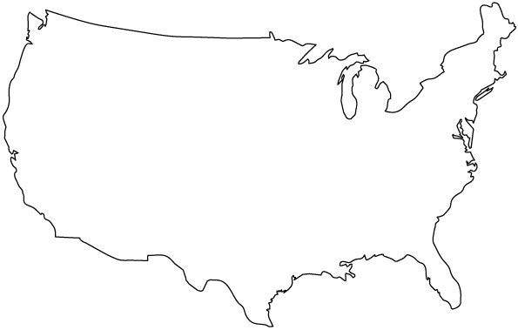
Nearly 1,000
687,000 foster children
Notes:
INSERT IMAGE OF WEB FOR TARGET CUSTOMERs
W/ real time data to make informed decisions

Slide 11
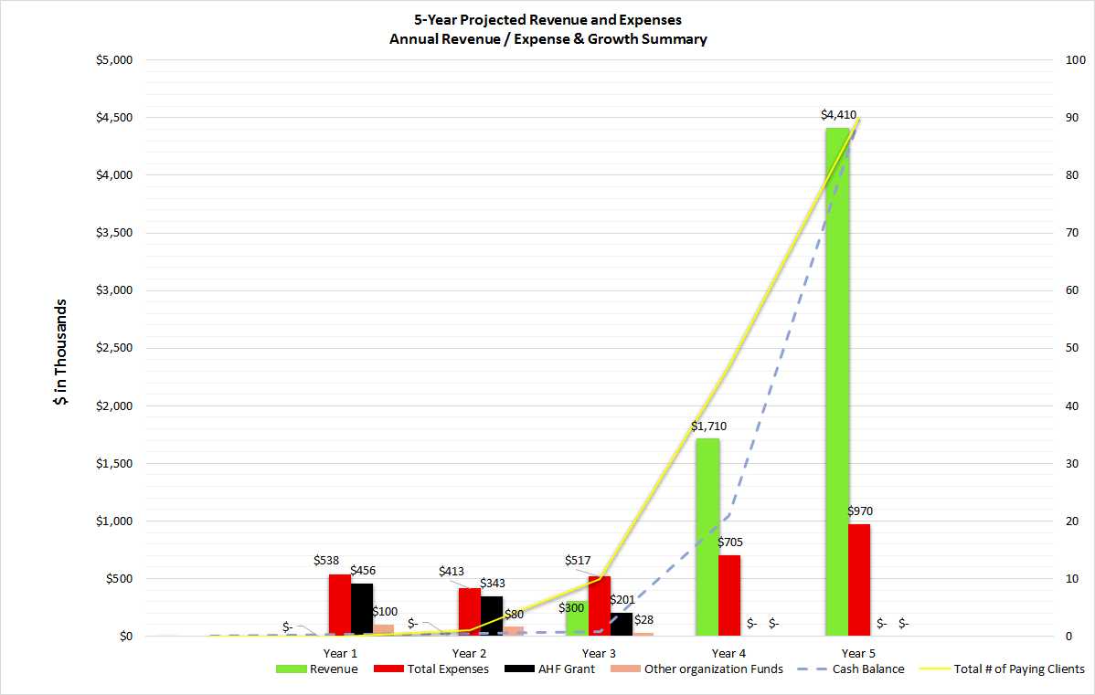
Startup Costs
AFH $1,000,000 VFC $ 208,000 Total Cost: $1,208,000 Funds will come from $300,000 annual budget surplus + reserves Ongoing costs Tech Support $175,000 Licensing $ 50,000
Sales $ 50,000
Marketing $ 25,000 TOTAL $300,000
Cost per client: $6,000/year
Revenue per client: $30,000/year
Net per client: $24,000/year
Notes:
This grant will….
SUSTAINABILITY PLAN CONSULTS WILL TRAIN OUR EXISTING TEAM

Slide 12
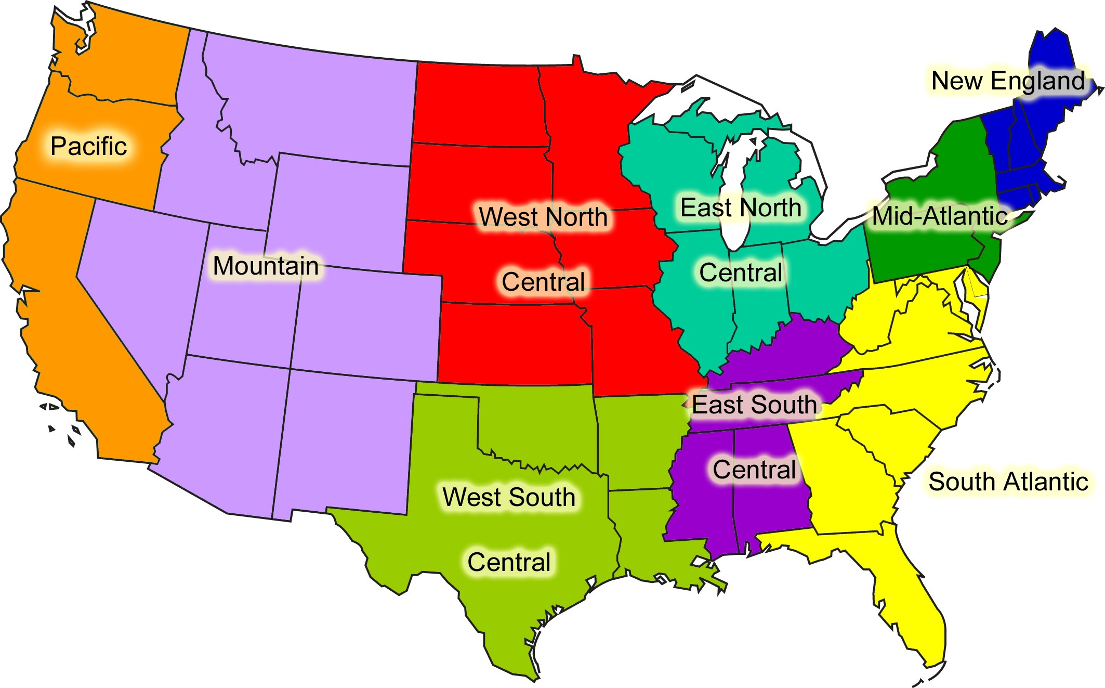
PRO | PLUS | SUPER
$1500/month | $2,500/month | $5,000/month
Up to 10 users | Up to 1,000 users | More than 1,000 users
Technical Support | Technical Support | Technical Support
Setup and training | Setup and training | Setup and training
Notes:
REVENUE CURVE ON THIS SLIDE
CONSIDER SOCIAL OFFSET ($1.6 billion annually)

Slide 13
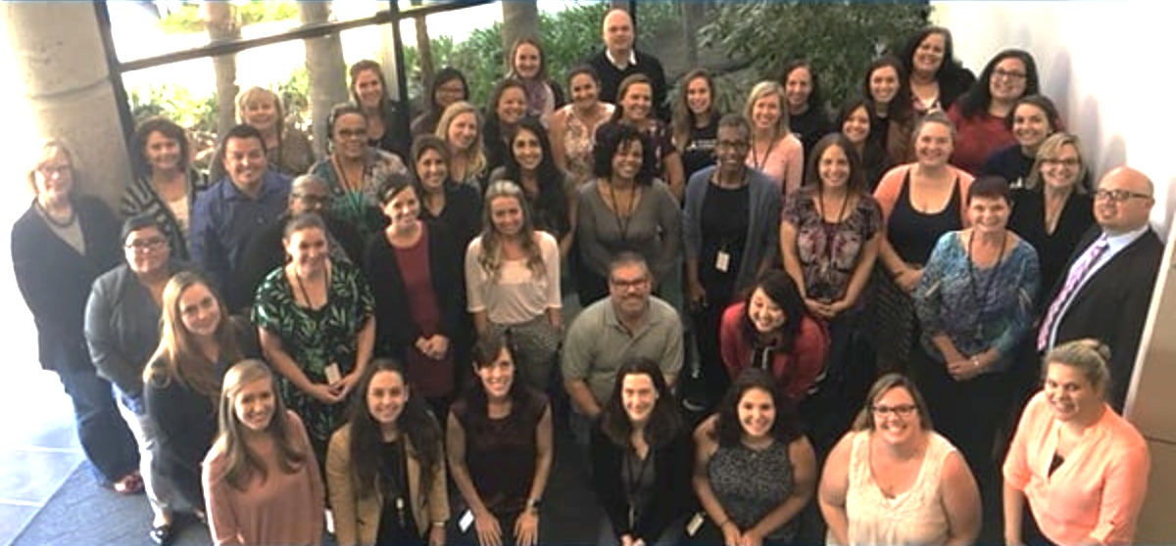
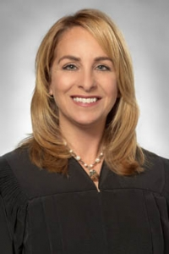
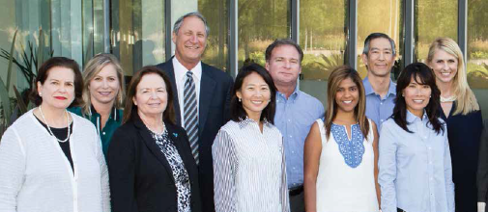
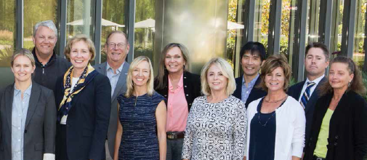
Partner
Organizations
Notes:
President/CEO, John Valencia: 20 years nonprofit management experience, Master’s Nonprofit Management & Organizational Development, created technology company & sold it, led major technology master plans for multi-college district, successfully implemented data sharing network between several large bureaucratic systems, Certified Salesforce Admin
Senior Vice President of Programs, Stephen Moore: VFC 10 years, total 17 years nonprofit work with children, leads professional team of 53 in advocacy, recruitment, and training
Director of Advocacy, Matt Olson: VFC 7 years, Developed VFC Staff Advocacy Program providing advocacy to 825 children annually, and case management database specialist
The professional staff at VFC: highly educated, experienced and second to none
Special Counsel, Carolyn Levenberg, JD, MSW: experience and expertise in delinquency and dependency Law
VFC Board of Directors: highly invested and committed, donating expertise and over $1 million annually
VFC partners with more than 60 organizations in San Diego: providing services to foster children—but VFC is the only organization authorized with Court access to all foster children and nonminor dependents, ages 0 to 21

Slide 14
Develop and launch a platform as a service to support all 687,000+ foster children in the U.S. through the nearly 1,000 Court Appointed Special Advocates (CASA) programs nationwide
WHO ARE WE? Voices for Children is the largest, self-funded CASA program in the nation and has created a model which serves every child in our county, plus we are the ONLY organization with DIRECT ACCESS & DATA to every foster child
CASA programs are demanding a cost-effective standardized method of data collection, case planning tools, and access to resources
Our PaaS will utilize Artificial Intelligence to build on existing data → predictive solutions
Voices for Children: 38 years of experience - “elite” program in the nation
$1.7B market which currently relies on donations → licensing revenue model to support all CASA orgs
$1M gets us to breakeven by year 3 and profitable by year 4

Slide 15
John Valencia
President/CEO
9370 Chesapeake Drive #210
San Diego, California 92123
JohnV@speakupnow.org
(858) 598-2263
www.speakupnow.org

